Slide 1


October 2024
Forecasting & Predicting stocks - Deep Learning Model
By: Rasesh, Erica, Brandon

Slide 2


Problem Identification
Why Forecast Stock Prices?
Predicting stock prices for Microsoft, Tesla, and Google can offer key insights for investors and analysts in the finance and tech sectors.
Accurate forecasts aid in informed investment decisions and strategic financial planning, addressing a critical need in market analysis.
Industry Impact
These companies drive significant market trends and innovation on a global scale.
By leveraging machine learning, our project connects finance and technology, highlighting AI’s role in modern investment strategies and the broader market landscape.

Slide 3
Data Collection
Data Source:
Collected historical stock data from Alpha Vantage API, focusing on three companies: Microsoft (MSFT), Tesla (TSLA), and Google (GOOGL).
Data Details:
Retrieved over 5 years of daily data to maximize trend and seasonality analysis, using all available historical data from Alpha Vantage.
Included daily price points (Open, High, Low, Close), trading volume, and optional technical indicators like moving averages to enhance analysis

Slide 4
Data Collection
Benefits of Using Alpha Vantage vs. Yahoo Finance
API Accessibility and Free Tier
Alpha Vantage: Offers a free API key with daily limits, allowing users to access a variety of market data without an upfront cost.
Yahoo Finance: While free for general browsing, it has more limited data API access unless you use third-party packages, some of which are unreliable or outdated.
Data Variety and Technical Indicators
Alpha Vantage: Provides extensive technical indicators (e.g., moving averages, RSI, MACD), which can be directly accessed through the API, saving time on calculations.
Yahoo Finance: Includes basic historical price data but lacks as many built-in technical indicators in its API.
Reliable Historical Data
Alpha Vantage: Offers a well-organized API for fetching historical data over various time frames, which is ideal for developing ML models with long-term data requirements.
Yahoo Finance: Reliable for end-of-day data but can sometimes be inconsistent or have gaps in historical data access through third-party packages.
Community and Documentation
Alpha Vantage: Known for clear documentation, making it beginner-friendly and easy to integrate into data projects.
Yahoo Finance: Limited official API documentation; often requires third-party libraries, which can lead to additional troubleshooting.

Slide 5
Model Selection and Advanced ML Methodologies
Deep Learning Model
LSTM (Long Short-Term Memory) or Transformer Models
Ideal for handling sequential time series data, like stock prices, where patterns and dependencies can span over time.
Libraries Used
Keras
High-level neural networks library, built on top of TensorFlow.
Simplifies building complex models, making it faster to experiment with LSTM layers.
Ideal for training and deploying deep learning models, especially within TensorFlow’s environment.

Slide 6
Implementation Steps
Step 1: Data Preparation
Preprocessing
Normalize/Scale Price Data
Adjusts the range of the data to improve model convergence and accuracy.
Helps in stabilizing the learning process and achieving better performance.
Feature Engineering
Enhance Predictive Power
Include relevant features such as:
Rolling Averages: Smooth out price data to identify trends.
Trading Volume: Offers insights into market activity and price movement potential.
Train-Test Split
Divide Data for Evaluation
Split the dataset into:
Training Set: For model training.
Validation Set: For tuning model parameters.
Test Set: To evaluate model performance on unseen data, ensuring robustness and generalization.

Slide 7
Model Development
Step 2: Model Architecture
LSTM Model in Keras
Purpose: Designed to capture sequential dependencies in time series data.
Advantages:
Memory Cells: Retain information for long periods, making them ideal for stock price forecasting.
Gate Mechanisms: Control the flow of information, allowing the model to learn patterns effectively.
Keras:
A high-level API that simplifies the process of building and training deep learning models within TensorFlow.
Provides a user-friendly interface to easily implement and experiment with LSTM layers and architectures.

Slide 8
Model Training
Step 3: Model Training
Training Framework
Keras (within TensorFlow)
Purpose: Provides a straightforward way to implement and train deep learning models, particularly LSTM architectures.
Flexibility: Allows for easy adjustments to the model architecture and training process.
Hyperparameter Tuning
Importance: Fine-tuning model parameters is crucial for achieving optimal performance.
Key Parameters to Adjust:
Layer Size: Determines the complexity and capacity of the model.
Learning Rate: Controls how quickly the model adapts to the training data.
Number of Epochs: Sets how many times the model will see the entire dataset during training.
Batch Size: Influences how many samples are processed before the model updates its parameters.

Slide 9
Model Evaluation
Step 4: Model Evaluation
Evaluation Metrics:
Measure performance using Mean Absolute Error (MAE) and Mean Squared Error (MSE), which are effective for regression tasks.
Visualization:
Use Matplotlib to plot actual vs. predicted prices to provide a visual assessment of accuracy.
Additional visualizations, such as highlighting trends and volatility, can deepen insights into the stock’s forecast behavior.

Slide 10
Results and Analysis
Model Performance Summary
Evaluation Metrics:
Mean Absolute Error (MAE):
For the first evaluation: 0.2110
For the second evaluation: 0.1073
Mean Squared Error (MSE):
For the first evaluation: 0.0511
For the second evaluation: 0.0125
Test Loss: 0.0664
Strengths:
The significant reduction in both MAE and MSE from the first evaluation to the second indicates that the model improved its predictive accuracy with further tuning or more training data.
The relatively low test loss suggests that the model is capturing the underlying trends in stock price movements effectively.
Areas for Improvement:
Despite good performance, there is room for enhancement, particularly given the nature of stock price forecasting, which can be influenced by many unpredictable external factors.

Slide 11
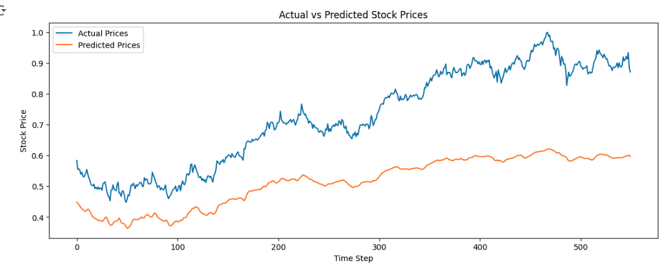
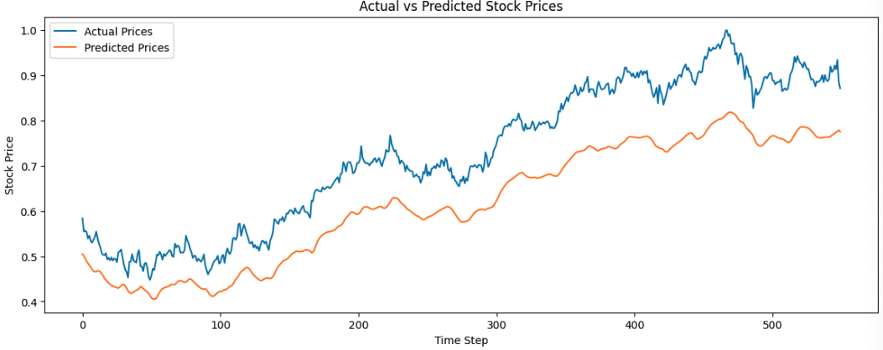
Results and Analysis

Slide 12
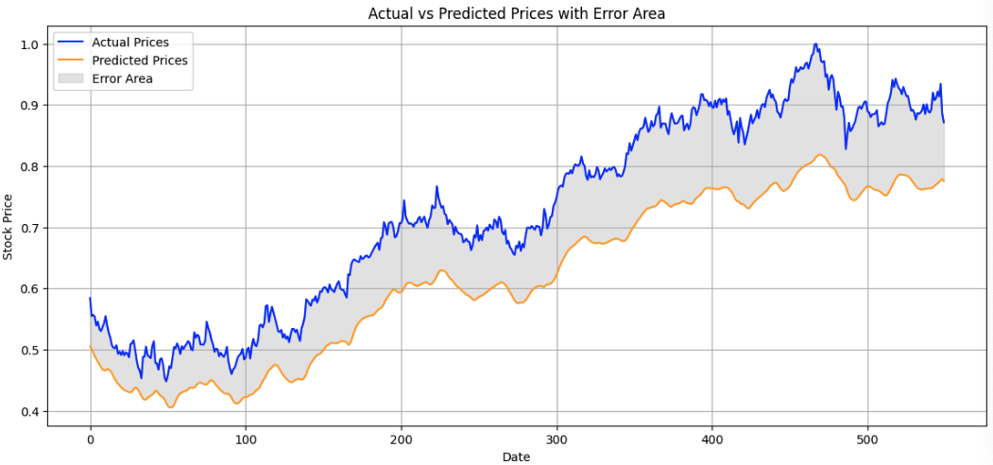
Results and Analysis

Slide 13
Final Conclusions
Future Model Improvements
While the model performs effectively in predicting general price movements, enhancements are necessary for it to become more robust and accurate in real-world scenarios. This model provides a strong foundation that could be expanded with additional data inputs and further fine-tuning, ultimately contributing valuable insights for investors seeking data-driven forecasts.
1. Enhanced Feature Engineering:
Technical Indicators: Add more advanced technical indicators, such as RSI, MACD, or Bollinger Bands, which can provide further insights into market momentum and trends.
Rolling Windows: Use rolling windows for features like moving averages to better capture stock price patterns over different time periods.
2. Advanced Hyperparameter Tuning:
Parameter Adjustments: Experiment further with layer sizes, learning rates, epochs, and batch sizes to optimize model performance and reduce errors.

Slide 14

Final Conclusions
3. Incorporate Sentiment Analysis:
News and Social Media: Use Hugging Face transformers to analyze sentiment in news articles or social media posts related to Microsoft, Tesla, and Google. Adding sentiment scores as input features could help the model react to public perception and sentiment-driven price changes.
4. Macroeconomic Factors:
Market Indicators: Include societal and economic factors such as interest rate changes, job market results, inflation rates, and monetary policy adjustments. These variables can heavily influence stock prices and improve the model’s accuracy in capturing real-world impacts.

Slide 15
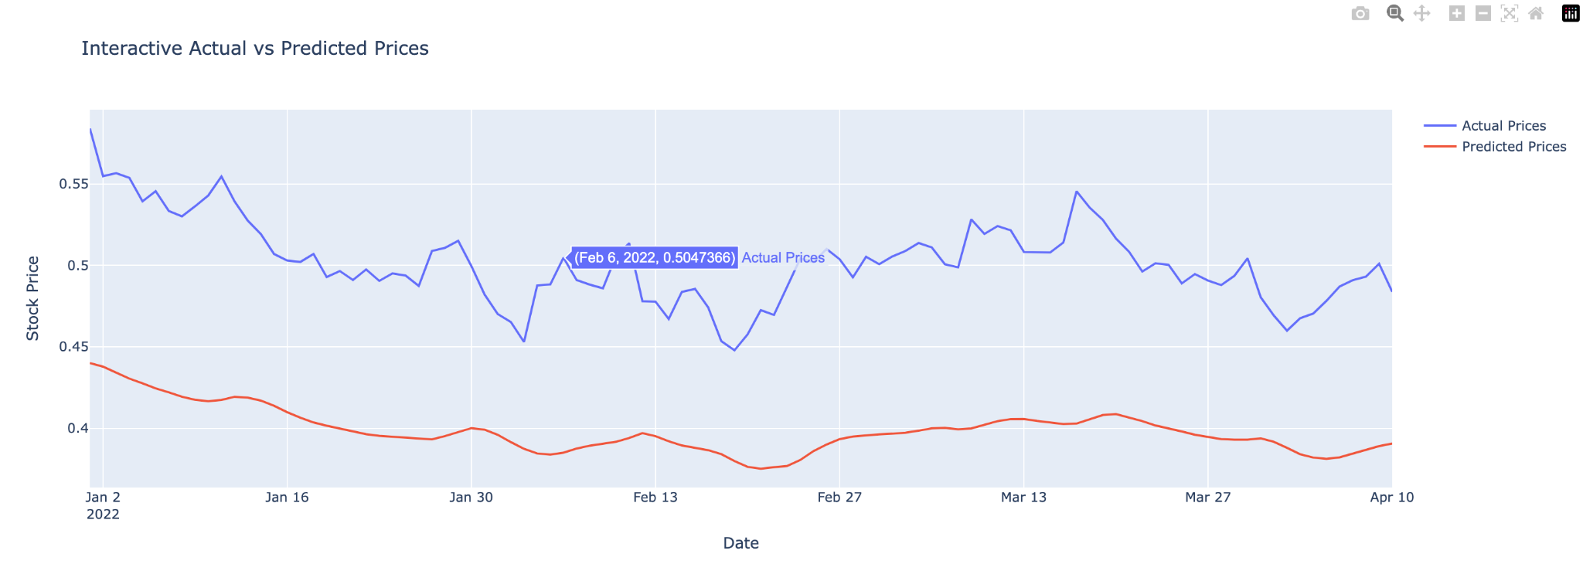

Slide 16
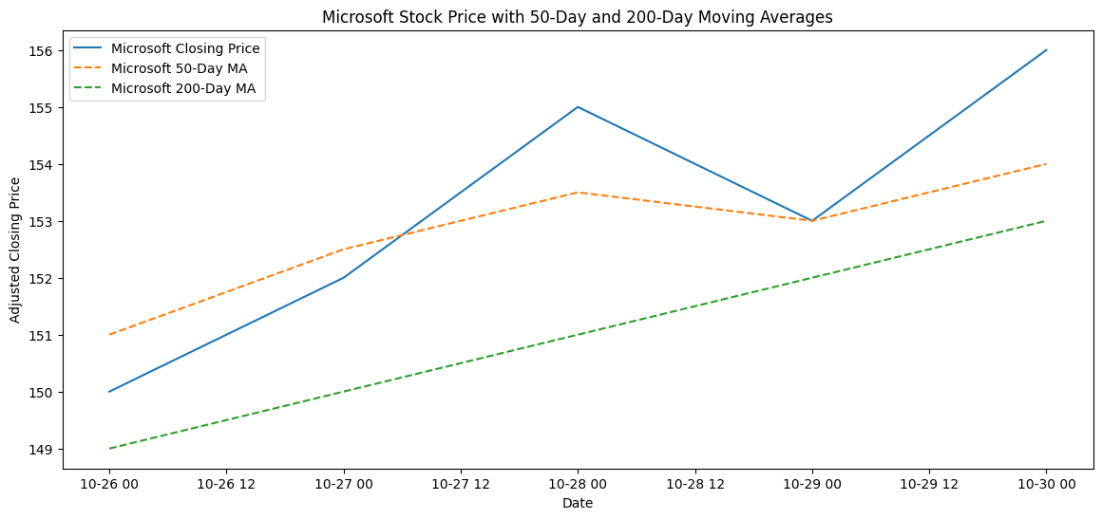
Moving Average Plot
Overlay the 50-day and 200-day moving averages on the closing prices for trend analysis.

Slide 17
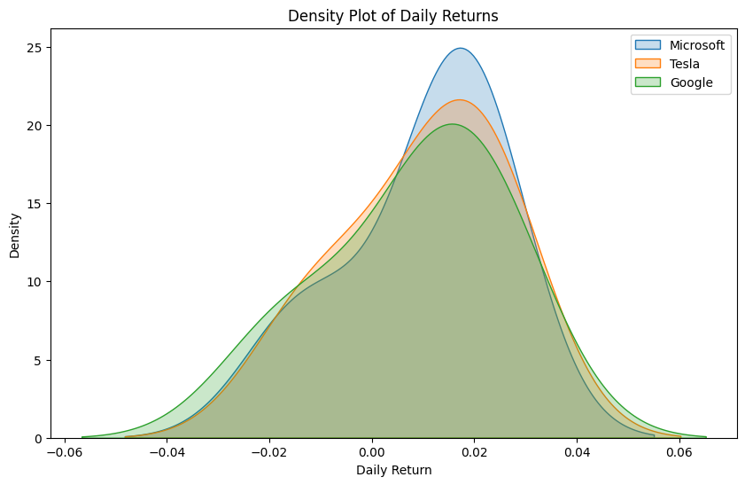
Density Plot of Daily Returns
A KDE plot shows the probability distribution of daily returns, useful for understanding stock volatility.

Slide 18
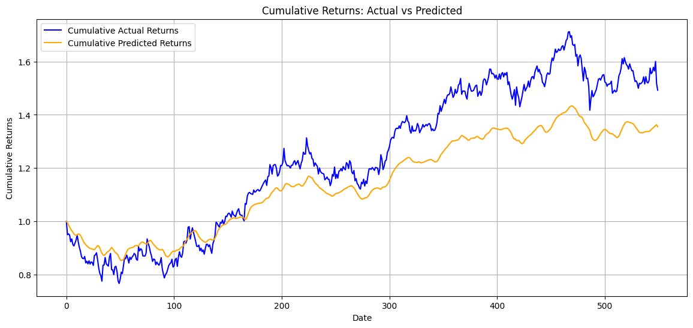
Cumulative Returns Plot for Actual vs Predicted
Plotting cumulative returns based on actual and predicted prices can help illustrate whether the model would have matched the trends over time.

Slide 19
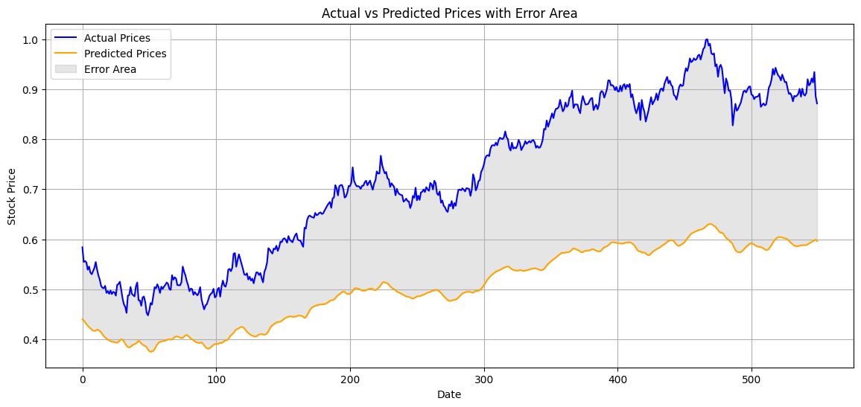
Time Series Plot with Actual, Predicted, and Error as Shaded Area
A time series plot with a shaded area for error provides a straightforward view of the performance over time and highlights periods of higher discrepancy.

Slide 20
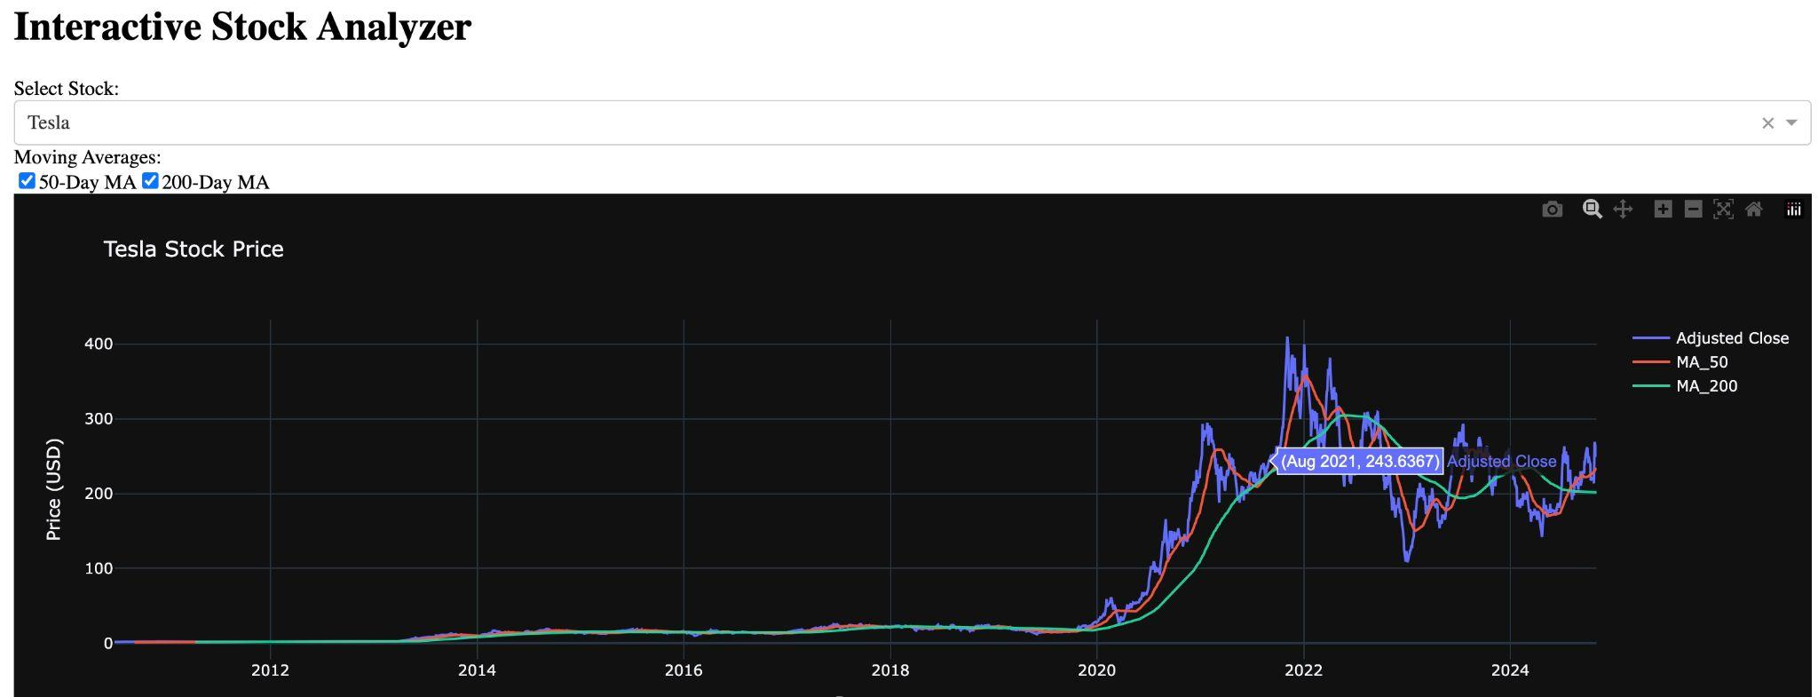

Slide 21
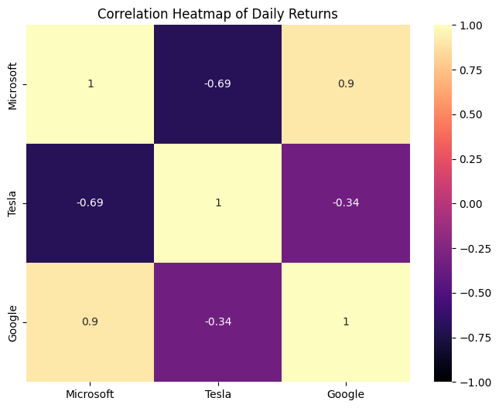

Slide 22
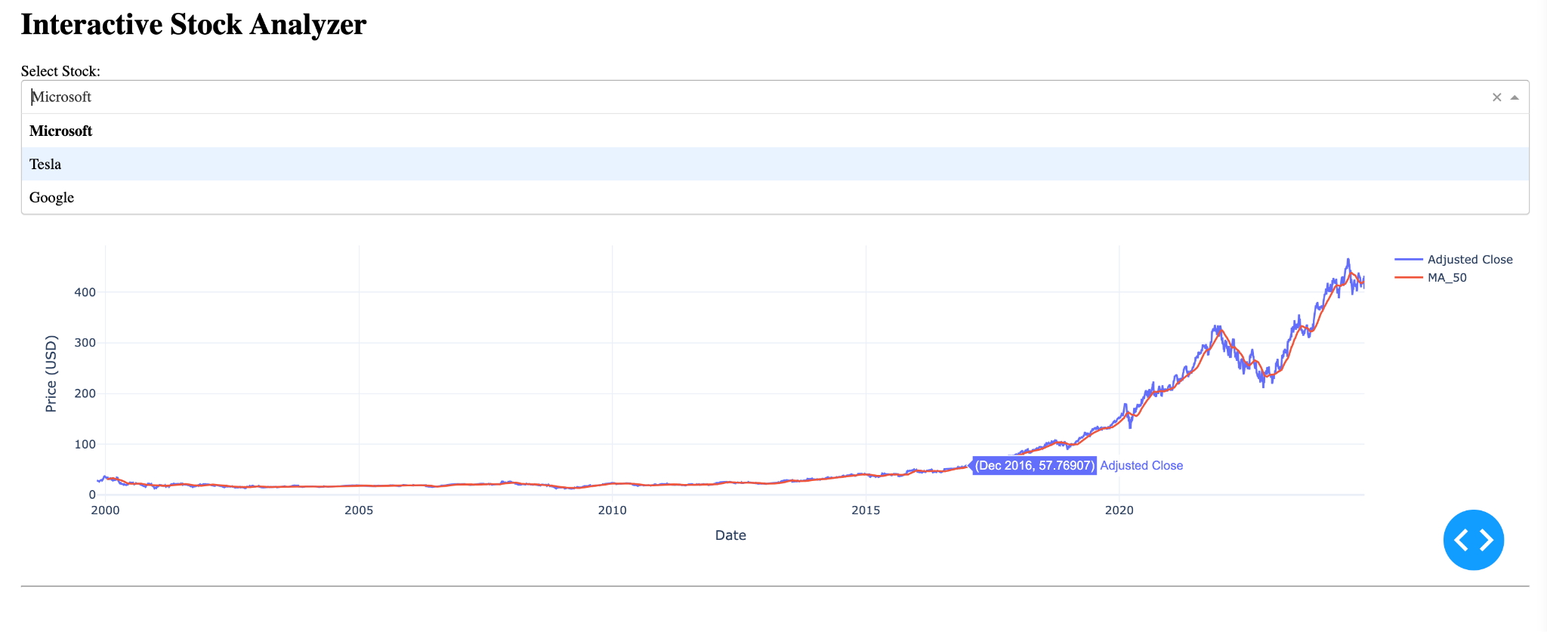
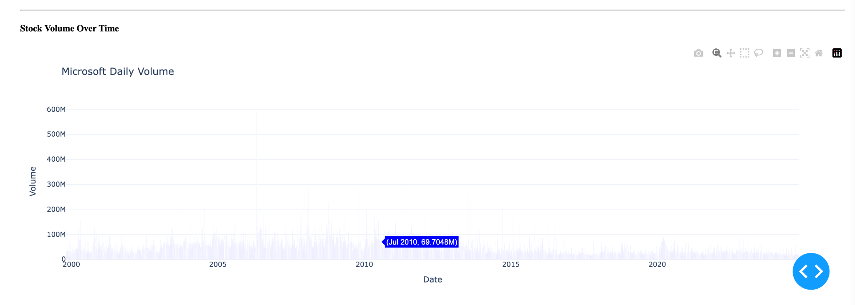
Interactive stock analyzer
To create an Interactive stock analyzer, we used Plotly Dash to build a web-based interactive applications with sliders, dropdowns, and more.
The simple dashboard below allows users the ability to select different stocks, view the stock’s daily prices, and add overlays like moving averages.
Code for an Interactive Stock Analyzer with Dash Installation
First, ensure you have Plotly and Dash installed: !pip install dash dash-core-components dash-html-components dash-bootstrap-components plotly
Dash App Code The following code sets up a basic interactive stock analyzer dashboard that shows stock prices and moving averages for Microsoft, Tesla, and Google.

